Slide 1
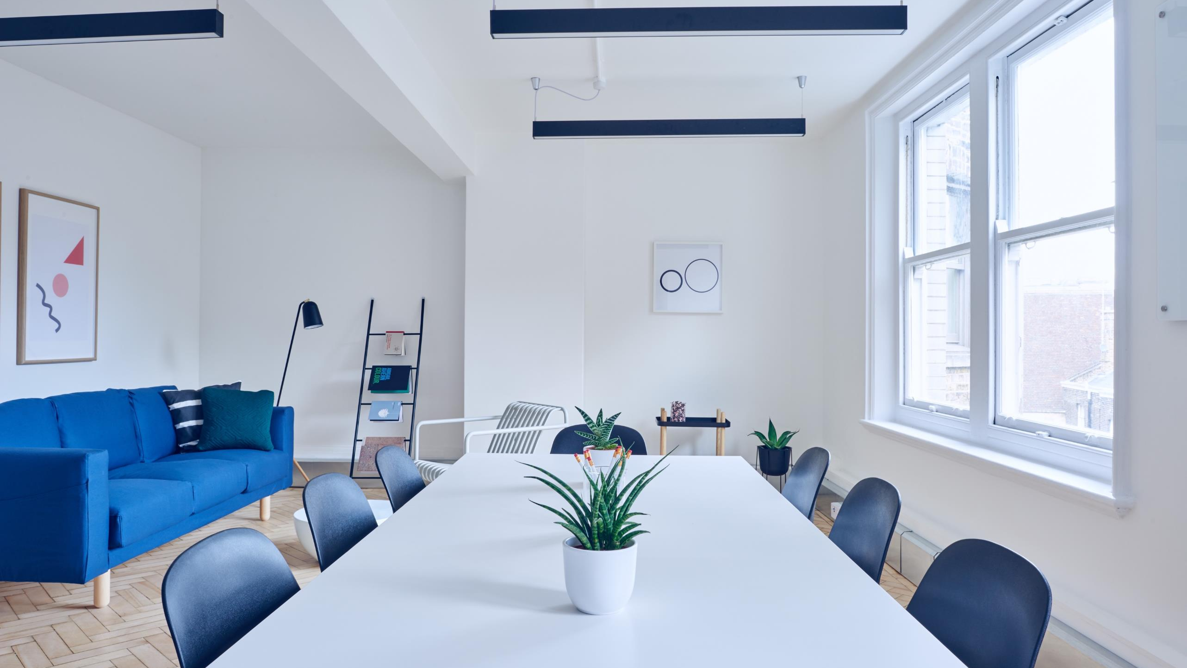

Industrial-
Organizational
Psychology

Slide 2
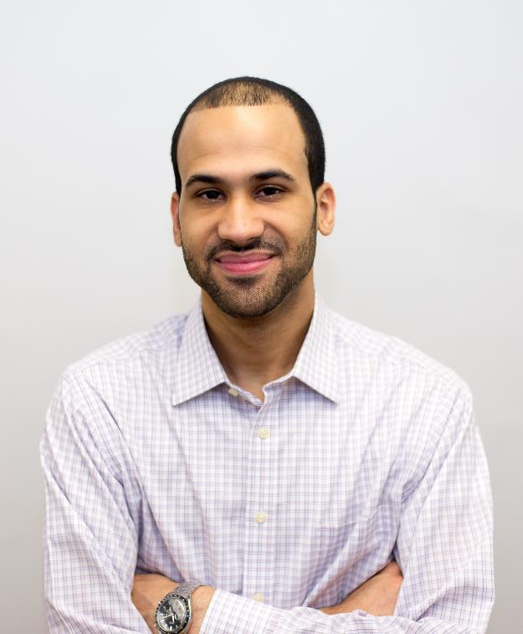
A little about myself
I-O Psychology Practitioner
Higher Education Administrator
Adjunct Faculty
Clemente I. Diaz
Clemente.Diaz@baruch.cuny.edu

Slide 3

Question:
How many of you plan on
getting a job someday?

Slide 4
How much time do we spend at work?
It’s often said we spend more time with our colleagues than anyone else but how long do we spend clocked in?
Years
Days
Hours worked over your life time
9.4
3,420
82,068
These figures are based on a 35-hour working week, an average of 253 working days a year, and an average retirement age of 64 years.
Source: Bonasio, A. (2018, Jul. 31). A lifetime of work in numbers. Medium.

Slide 5

I-O Psychology?
Huh?
The scientific study of human behavior in
Organizations and the workplace.
Scientist-Practitioner

Slide 6
Industrial-Organizational Psychology
Industrial
Organizational
Testing
(personality, intelligence, etc.)
Leadership
Recruitment, Selection, and
Promotion
Employee Motivation
Training &
Development
Organizational Development
Performance
Evaluations
Workplace Health

Slide 7
Why should you consider becoming an I-O psychologist/practitioner?

Slide 8
Here’s why.
01
#1 Fastest growing occupation in the U.S.,
with a growth rate of 53% between 2014 and 2022.
02
#2 Best science job.
03
#20 Best STEM job.
04
#46 Best overall job
Sources: U.S. News & World Report (2019). Industrial Psychology: Overview.
Riggio, R.E. (2014). Which area of psychology is the US’s fastest growing career? Psychology Today.

Slide 9
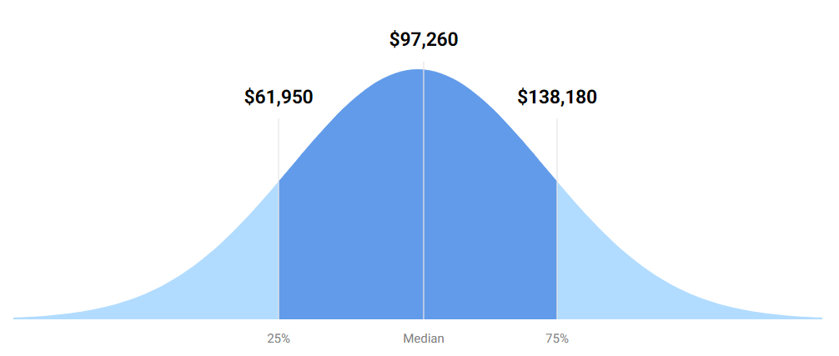
How much does an I-O psychologist make?
I-O psychologists made a median salary of $97,260 in 2018. The best-paid 25 percent
made $138,180 that year, while the lowest-paid 25 percent made $61,950.
Source: U.S. News & World Report (2019). Industrial Psychology: Overview.
.

Slide 10
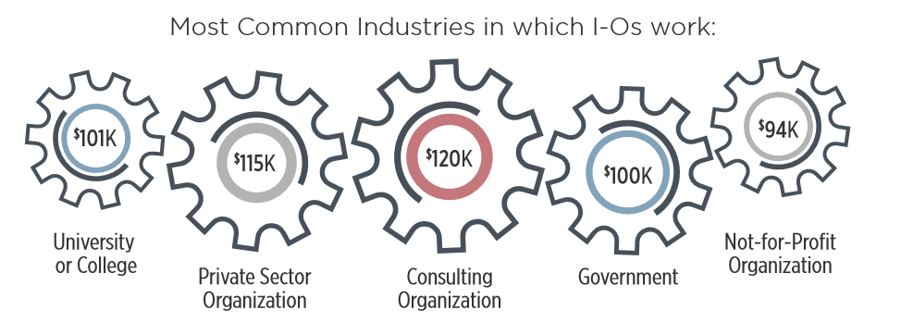
Where do I-O psychologists work?
I-O psychologists typically work in academia, applied settings (e.g., private sector, consulting firms, or government), or both.
Source: Society for Industrial and Organizational Psychology (SIOP)

Slide 11
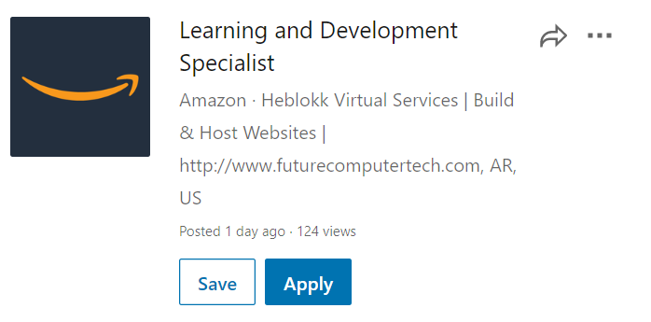

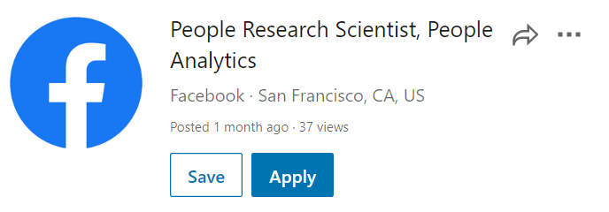
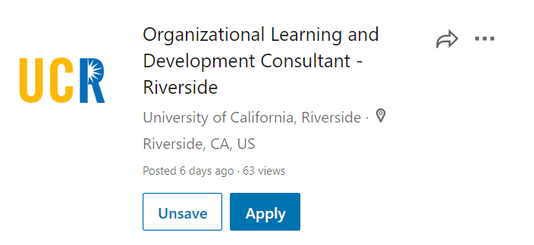
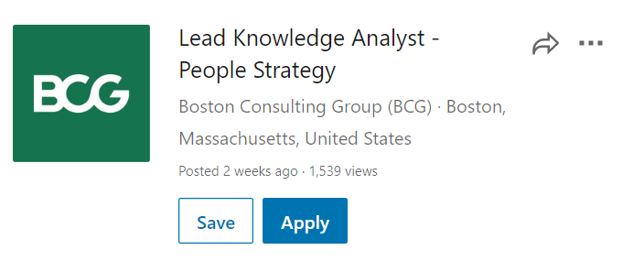
What are some job titles in applied settings?
I-O psychologists typically work in academia, applied settings (e.g., private sector, consulting firms, or government), or both.

Slide 12

TOP 10 Workplace Trends 2020
1. Artificial Intelligence and Machine Learning
2. Diversity, Inclusion, & Equity
3. “Gig Economy” – Contract Work
4. Working With Big Data
5. The Changing Nature of Work
6. Automation of Jobs and Tasks
7. Algorithmic Selection – Validity, Bias, & Application Reactions
8. Workforce Health & Well-being
9. Meaning & Purposeful Work (TIE)
9.. Virtual Working Spaces (TIE)
10. Data Visualization & Communication
Source: Society for Industrial and Organizational Psychology (SIOP)

Slide 13
How can you get started?

Slide 14
How to become an I-O psychologist/practitioner?
A doctoral degree gives you a broader education and allows you access to academic, research and scientific jobs that aren’t open to candidates with just a master’s degree
03
02
A master’s degree gives you a somewhat narrow breadth of training in the field.
01
To enter the field, a master’s degree in I-O is required.
Source: U.S. News & World Report (2019). Industrial Psychology: Overview.
.

Slide 15
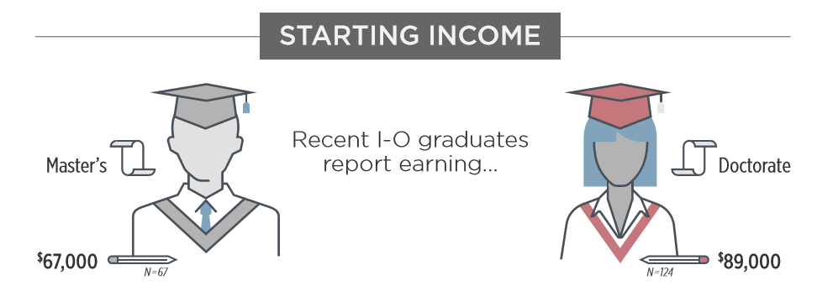
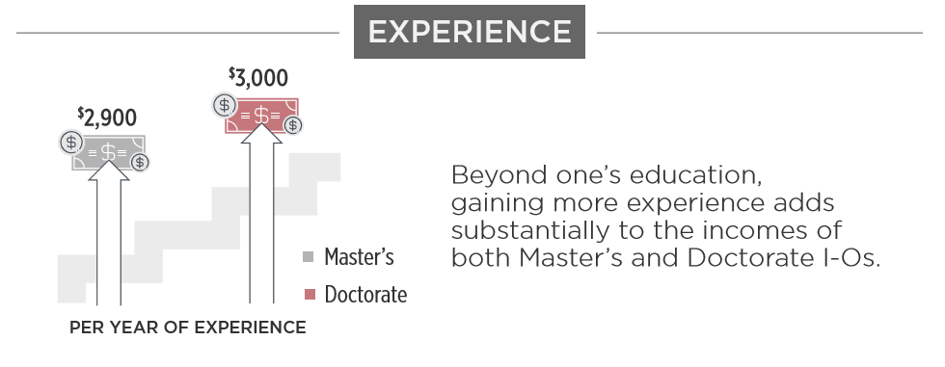
How to become an I-O psychologist/practitioner?
Master’s programs
Doctoral programs
Tend to take 2-3 years to complete
Generally aim to train students to be practitioners within organizations and consulting firms
Tend to take approximately 4-6 years to complete.
Usually focus on training students to become scientists who will work in academic settings or organizations conducting research and developing the science of I-O.
Source: Crain, T.L. (2017). From Classwork To Applied Experience: Understanding The Life Of An Industrial-Organizational (I-O) Psychology Graduate Student. Psych Learning Curve.

Slide 16

Is I-O the right career path for you?
Interested in psychology?
Want to make a big impact?
Want to conduct research and/or apply
science in real-world settings?
If you say “yes” to above, then I-O might be the right career for you!

Slide 17
Questions?

Slide 18





Interested in learning more?
Society for Industrial and Organizational Psychology (SIOP)
  @SIOPOfficial
  www.siop.org
  @SIOPTweets
  Society for Industrial and Organizational Psychology (SIOP)
  @SIOPOfficial

