Slide 1

INDUSTRIAL-ORGANIZATIONAL PSYCHOLOGY
AN INTRODUCTION

Slide 2

Agenda
  Explain the overall purpose of I/O Psychology
  Describe what Industrial Psychology entails
  Describe what Organizational Psychology entails
  Discuss SIOP and a career path in I/O Psychology

Slide 3
How many of you…
  Have a job?
  Have had a job?
  Want a job?
Notes:
Have a job? (i.e. retail, restaurant, server, etc.)
Have had a job? (i.e. even babysitting…)
Want a job? (perhaps after high school or college)

Slide 4
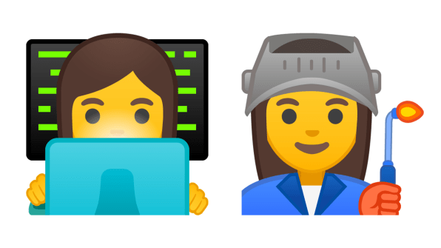

Work
  Working is a central part of people’s lives around the world…
  “Full-time workers in the U.S. work an average of 8.5 hours per day, spending more time working than performing any other life activity except for sleep” (Bureau of Labor Statistics, 2016)

Slide 5
Changing World of Work
  The world of work is constantly changing in many ways, presenting news questions and challenges…
  Advances in technology, changing or eliminating jobs
  Alternative work arrangements, such as “gig” jobs (Uber)
  Diversity and inclusion in the workplace
  Remote working and successfully dealing with a pandemic
  How does Industrial-Organizational Psychology play a part?

Slide 6
Artificial intelligence and machine learning
“Gig economy” – contract work
Diversity, inclusion, and equity
Working with big data
The changing nature of work
Automation of jobs and tasks
Top Workplace Trends of 2020 (SIOP)
Algorithmic selection – validity, bias, and applicant reactions
Workforce health and well-being
Meaning and purposeful work / Virtual working spaces
Data visualization and communication
Notes:
The 2020 video on YouTube is not out yet
*Could be updated once 2021 list is out, and so forth.
Link if hyperlink doesn’t work:
https://www.siop.org/Research-Publications/Items-of-Interest/ArtMID/19366/ArticleID/3361/Top-10-Workplace-Trends-for-2020
1. Artificial intelligence and machine learning
2. Diversity, inclusion, and equity
3. “Gig economy” – contract work
4. Working with big data
5. The changing nature of work
6. Automation of jobs and tasks
7. Algorithmic selection – validity, bias, and applicant reactions
8. Workforce health and well-being
9. Meaning and purposeful work / Virtual working spaces
10. Data visualization and communication

Slide 7
Industrial-Organizational Psychology
  “…the scientific study of working and the application of psychological principles to workplace issues facing individuals, teams, and organizations”
  Trained as scientist-practitioners (can conduct research and engage in the practical application of science)
  Apply the scientific method to study issues and conduct research about work
  Apply research findings to the design of organizational, group, and individual activities at work
Notes:
What is Industrial-Organizational Psychology? (definition)
I/O psychologists are… training as scientist-practitioners (meaning they can conduct research but are also able to apply this scientific knowledge to the world of work)
- Apply the scientific method to study issues and conduct research about work
- Apply research findings to the design of organizational, group, and individual activities at work
….and are often internal and external consultants in organizations, sometimes government employees, and college professors…

Slide 8
Industrial-Organizational Psychology
Two distinct, related components in the field…
The Industrial half focuses on the analysis of jobs, the recruitment, selection, and training of employees, and the evaluation of performance in the workplace (sometimes referred to as Personnel Psychology)
Research and practice topics include: job analysis, recruitment and selection, performance appraisal, training and development…
Notes:
We will begin with industrial psychology…
Focuses on…
Industrial Psychology is a close partner of HRM in organizations, with Industrial psychologists supplying the technical and legal expertise to create and evaluate the personnel systems that HR managers use on a daily basis

Slide 9
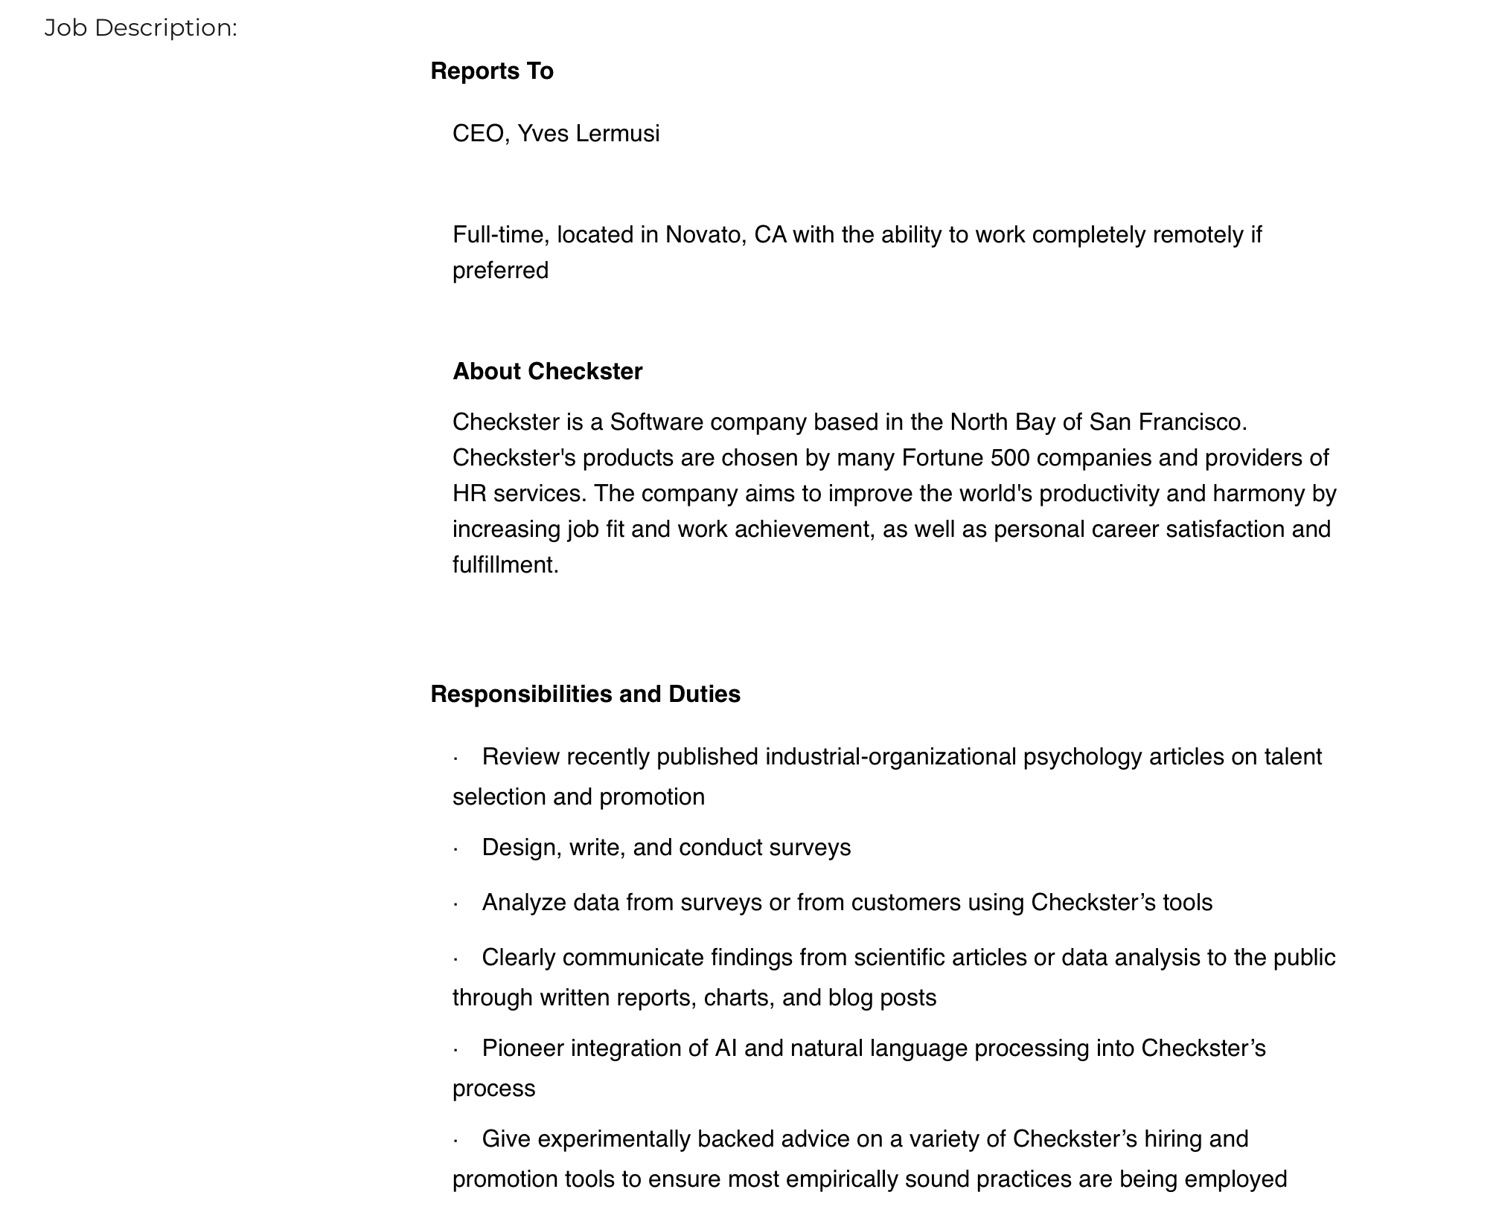
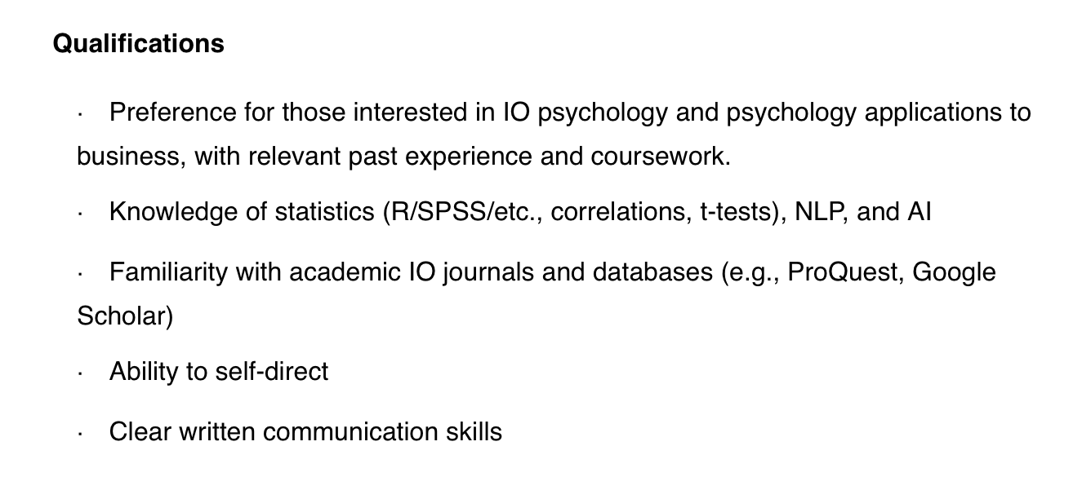
Job Analysis
  What tasks the job entails
  What skills the job requires
  Where the job fits in the organization
  How many of you have seen something like this in a job search?
Notes:
Before we can hire people, or train them, whatever it may be in relation to a job, we must first understand what the job consists of…
A job analysis allows us to understand…
- What tasks the job entails
- What skills the job requires
- Where the job fits in the organization
Image sourced from: https://www.siop.org/Career-Center/Job-Search

Slide 10
Job Analysis
  The job description and the knowledge, skills, and abilities (KSA’s) required for the job are defined through a job analysis
  Work-oriented job analysis: focuses on the job itself and involves developing a list of tasks that the job entails
    - Produces the job description
  Worker-oriented job analysis: focuses on identifying the qualities needed by a person to successfully perform the job - Produces the KSA’s
  Both involve consultants interviewing current employees and supervisors and surveying these employees to gather information about the job
Notes:
Job analysis can fall under one of two categories:
Work-oriented and worker-oriented...
Work-oriented example: For example, a retail store sales clerk might assist customers in finding merchandise, answer customer questions, use a cash register to take money and make change, bag the merchandise, and thank the customer among other responsibilities
KSA’s: knowledge (things they know), skills (such as presentation skills), abilities (more stable, such as mathematical ability)
Worker-oriented example: For example, a retail sales clerk might need to be friendly, detail-oriented, reliable, and have the ability to learn about new merchandise the store has in stock…
Fairly similar, both involve…

Slide 11
Recruitment, Selection, and Placement
  Focused on attracting people to submit applications for open positions within an organization (LinkedIn)
Recruitment
  Process used to evaluate job candidates and decide which ones to hire
Selection
Placement
  Placing the candidate in the role and preparing them for success
Notes:
Once an I/O psychologist understands what a job entails, and the requirements necessary to do the job, they can use this information to aid in the hiring process…
Recruitment is focused on attracting people (preferably the right people) to submit applications for open positions in an organization. Nowadays, this is typically done using technology (i.e. LinkedIn, Facebook, Google, Indeed.com, etc.). I/O psychologists typically help organizations attract the right candidates based on the job analysis and the culture of the organization
Once you recruit candidates, you have to select the right candidate for the role…

Slide 12
Personnel Selection
  One of the oldest topics in I/O psychology
  Usually involves administering a series of instruments (called predictors) to determine the best applicant
  I/O psychologists help deliver effective predictors
  Common predictors include tests of various qualities (intelligence, personality, other traits) and interviews
  Determine the right set of predictors based on a number of factors (time, cost, legality, validity, reliability, practicality…)
    General mental ability is the single most effective predictor of job performance
    Big 5 – Conscientiousness – said to be an important predictor
    Interviews? – not very effective for evaluating applicants
Notes:
One of the oldest topics in I/O psychology
Usually involves administering a series of instruments (called predictors) to determine the best applicant
I/O psychologists help deliver these effective predictors
Common predictors include tests of various qualities (intelligence, personality, other traits) and interviews
I/O psychologists help determine the right set of predictors based on a number of factors (time, cost, legality, validity, reliability, practicality, and acceptance)
SO what are some predictors discussed in I/O psychology:
General mental ability is the single most effective predictor of job performance
Ever heard of the Big 5 (personality test)? The trait: Conscientiousness (Big 5) is said to be an important predictor for job performance as well– not surprising as those high in conscientiousness tend to be hard-working, reliable, and organized
What about interviews? Well since most interviews tend to be flexible conversations rather than more structured around a set of criteria, they are not very effective for evaluating applicants…(however by this point, potentially, you have already significantly narrowed down your applicant pool)
Once you have selected the right candidate and placed them in the role, you can focus on training and developing the employee, and assess their performance…

Slide 13
Worker Performance
Important to evaluate and document employee performance for future decisions (i.e. promotions, training, rewards, termination)
  Performance Appraisals
  Structured around the employee’s performance of their primary tasks and responsibilities (job analysis)
  Involves ranking numeric scales corresponding to specific aspects of performance, typically their task performance, and often includes examples/comments of critical incidents
  Sometimes concerned with additional behaviors (i.e. organizational citizenship behaviors and counterproductive work behaviors)
Notes:
Important to evaluate and document employee performance to understand potential gaps and to help with future decisions (i.e. promotions, training, re-assigning, or terminating…also can be used to determine compensation, bonuses, and rewards)
How many of you have ever had a performance appraisal? Where a boss or a manager has sat down and discussed how you were doing in your role and/or some potential areas that needed improvement?
Performance appraisals are a review of the employees performance and going back to the job analysis, I/O psychologists design performance appraisal following the job analysis so the employee’s performance is appraised around the primary tasks and responsibilities of the employee and their performance
Task performance = how effectively an employee performs the key requirements of their role
Critical incidents = specific examples of performance
Sometimes concerned with additional behaviors aside from their task performance, such as organizational citizenship behaviors (or OCB’s) = positive displays of behavior outside the job description (i.e. bringing donuts to an early morning work meeting) as well as counterproductive work behaviors (or CWB’s) = negative behaviors that are minor (i.e. being rude to a co-worker from time to time) or major (harassment of a co-worker or engaging in a criminal activity such as theft or arson)…

Slide 14
Industrial-Organizational Psychology
  The Organizational half focuses on many different levels of workplace phenomena
    Micro: Individual level (i.e. attitudes and emotions)
    Meso: Group level (i.e. teamwork, interpersonal discrimination)
    Macro: Organization level (i.e. leadership, organizational culture)
  Research and practice topics include: employee attitudes, worker health and safety, motivation, teamwork and leadership…

Slide 15
Micro: Individual Level
  Concerned with attitudes employees hold about their jobs…
  Job Satisfaction: an individual’s overall satisfaction with their job
    Widely studied in I/O and said to have strong links with performance, motivation, and extrarole behaviors (outside job description)
  Organizational Commitment: an individual’s psychological attachment to an organization
    I/O has identified three types of commitment and a strong link has been found with org. commitment and employee turnover
  Organizational Justice Theory: employees pay attention to the fairness of how they’re treated
Notes:
I/O psychologists are often concerned with the attitude employees hold about their work.
Several attitudes have been the focus of extensive I/O psychology research over the past few decades, including job satisfaction, organizational commitment, organizational justice theory, and worker health and safety…
Three types of organizational commitment with examples:
- Affective: an emotional connection an employee may feel with their organization (i.e. part of a family in their organization)
- Continuance: commitment based on a lack of available alternative employment options (i.e. may stay because of poor job prospects or they don’t have the training or qualifications for other jobs)
- Normative: driven by an employee’s sense of obligation to their organization (i.e. if a company gives an employee their first job after graduating from college, or has invested resources in an employee in the form of training or development they may feel obligated to stay and ”pay back” the organization with their commitment)
An employee’s attitudes about an organization may also be based on how fairly they feel they are treated…
Organizational Justice Theory…
Employee attitudes have a significant impact on individuals, group dynamics, and organizational outcomes, which is why I/O psychologists study them…
*VIDEO* we can incorporate this if we want on the slide, just to demonstrate the importance of understanding employee attitudes in a funny and engaging way…
Job satisfaction and Organizational commitment (funny) example: https://www.youtube.com/watch?v=jKYivs6ZLZk

Slide 16
Motivation
  The force that directs employee’s behavior at work and has had a long history in I/O psychology…
  Hugo Munsterberg - knitting mills - 12 hour days, 6 days a week
    …Had kittens play with balls of yarn on the factory floor which increased job satisfaction and alertness of employees
  Goal-Setting Theory (Locke and Latham, 1990)
    Goals can influence the direction of actions, affect the effort employees put into those actions, increase persistence, and motivate employees to choose more effective strategies in attaining their goals
    Specifically, if they are SMART goals
Notes:
I/O psychology research on motivation dates back to Hugo Munsterberg, who studied motivation issues for employees working in knitting mills…he noticed they were working 12 hours a day, 6 days a week and by implementing some modifications, including having kittens play with balls of yarn on the factory floor, was able to increase employee’s job satisfaction and alertness.
Since then, I/O psychologists have developed many theories of motivation…
Goal-Setting Theory: goals influence employees in a variety of ways…
*VIDEO* we can incorporate this if we want on the slide, just to demonstrate the importance of understanding employee attitudes in a funny and engaging way…
- Motivation and Performance (funny) example: https://www.youtube.com/watch?v=BTdOHBIppx8

Slide 17
Motivation
  Expectancy Theory (Vroom, 1964) suggests employees are unlikely to be motivated unless they can provide affirmative answers to three questions:
    Will my effort lead to performance (Instrumentality)?
    Will my performance be rewarded or recognized (Expectancy)?
    Will I value the rewards that I will receive (Valence)?
  Job Characteristics Theory (Hackman and Oldham, 1976) suggests that several key factors of the job influence employee’s motivation
    For example, having autonomy (or freedom to choose how their work is done) has been shown to have a positive effect on employee motivation
Notes:
****Not sure if we want to incorporate this slide, might be too much/long
Expectancy Theory (Vroom, 1964) suggests employees are unlikely to be motivated unless they can provide affirmative answers to three questions:
Will my effort lead to performance (Instrumentality)?
Will my performance be rewarded or recognized (Expectancy)?
Will I value the rewards that I will receive (Valence)?
If these answers are no, Vroom’s theory suggests employee’s will be low in motivation or might not be motivated at all…
What do you think? Do you agree with this theory?
Job Characteristics Theory…

Slide 18
Meso: Teamwork
  In many organizations today, work is often conducted in the context of a group or team…
  Teams are defined as two or more individuals who share one or more common goals
  Teams are influenced by a variety of social dynamics, and naturally, social psychology is relevant to the study of teams
    For instance, many people have a tendency to work with less intensity when they are in a group compared to when they work individually (what social psychologists call social loafing)
Notes:
…A natural sister topic of teams concerns the individuals tasked with facilitating teams…

Slide 19
Macro: Leadership
  Leaders influence and guide others towards a goal…
  1920’s and early 1930’s focused on the trait approach
    Centers on the idea that leaders possess certain traits that non-leaders do not (i.e. ambition, dominance, extroversion, height)
    However, this research proved to be inconsistent
  In 1962, Fleishman and Harris defined leadership through two dimensions, consideration (concern for individuals needs) and initiating structure (organizes and defines activities)
    In modern research, this is now explored as transactional and transformational leadership (Bass, 1985)
Notes:
While there are many definitions of leadership, the common elements of leaders are to…
I/O psychologists have studied leadership from several different perspectives across the years
…I/O psychologists have continued to explore and contribute to the understanding of leadership and how we best develop and coach the leaders of today and tomorrow

Slide 20
Thought Exercise!
  How do you think I-O psychologists help to inform, improve, or enhance the changes, issues, or concerns at work?
  Diversity, Inclusion, Equity?
  Virtual Workspaces?
  Workforce Health and Well-being?
  (Top Workplace Trends of 2020)
Notes:
Knowing what you now know about what an I-O psychologist is and some of the focuses in I-O psychology, let’s think about the top workplace trends of 2020 (discussed in the first few slides) – How do you think I-O psychologists help to inform, improve, or enhance the changes, issues, or concerns at work?
Perhaps in relation to:
Diversity, Inclusion, Equity?
Virtual Workspaces?
Workforce Health and Well-being?

Slide 21
Diversity, Equity, and Inclusion
  Recruitment, Selection, and Placement: Discrimination Law
  Worker Performance Ratings – Equity (Job Analysis)
  Team dynamics – Acceptance (inclusion), Culture
  Leadership – Perceptual errors, Culture, Inclusion
Notes:
Let’s discuss in relation to Diversity, Equity, Inclusion:
Something that has always been and will always be important in the workplace, and researchers have studied the positives of diversity, inclusion, and equity at work (such as increased productivity, motivation, job satisfaction, better employer brand, etc.), but this is an area which still requires prominent change in organizations…
I/O psychologists can inform, improve, or enhance diversity, inclusion, and equity in many ways…
Recruitment, Selection, and Placement: Discrimination Law (for example, illegal to discriminate on the basis of race… but also best-practice (we shouldn’t do that regardless, strive for inclusivity); however, not all groups are protected, for example, illegal to discriminate on the basis of age, but only those above 45…(discrimination laws are also stately)
Worker Performance Ratings – Ensuring equity in relation to performance ratings, making sure performance is based on the knowledge, skills, and abilities required for the role based off of the job analysis, not anything else
Team dynamics: Acceptance (inclusion) and organizational culture
Leadership – Making sure leaders understand perceptual errors and seek to inform themselves of their own biases and others of biases to establish a diverse, equal, and inclusive work environment and culture as well as make decisions that are fair and not based on perceptual errors (stereotyping, bias, prejudice, etc.)

Slide 22
Career Paths in I/O Psychology
Academia
Consulting
Industry
Government
Professor in Business or Psychology, Administrator
External, Specialist
Medium and Large Companies
NASA, Military, Large Agencies
Notes:
Academia – you can go into business or psychology departments; even if you don’t go full-time into this option, many I/O psychologists teach on the side at the college level.
Consulting – you can work for a large or small consulting company, usually specializing in a few areas of I/O psych and doing that for a lot of different clients who can’t or don’t want to hire their own I/O psychologists internally
Industry – you can work for medium-large sized companies as a higher level strategic employee, those who are large enough to hire their own I/O psychologist. You would typically work in Human Resources, Organizational Development, or similar areas of the organization to do a broader variety of things than you might if you work for a consulting company and specialize
Government – lots of interesting work done by I/O psych in government, including mapping out the future of the space program and teams sent to space!

Slide 23
Interested in Pursuing a Career in I/O Psychology?
  Over 500 graduate programs in the U.S. that grant master’s and doctoral degrees in I/O psychology and options abroad
  You do not need a doctoral degree to practice, a Master’s degree is sufficient to pursue a career in I/O Psychology
  One of the fastest growing careers
  Interested? Check out SIOP.org
  for more information
Notes:
With changing workforce practices, such as the utilization of temporary workers, teleworking, virtual teams, increasing diversity in the workforce and other existing ambiguous boundaries that modern jobs hold, I/O psychologists will become increasingly important for helping both workers and organizations weather these changes.
We haven’t covered every topic within industrial-organizational psychology today, but we hope this introduction course has peaked your interest in I/O psychology…
If you are interested in pursuing a career in I/O…
End with SIOP video:
30 second version: https://youtu.be/Wamkx8luZf4
60 second version: https://youtu.be/9LD19HOy4hM
5 minute version: https://youtu.be/DLR6eCrLih0"

Slide 24
Thank you for your time!
Questions?
Presenter’s Name
Contact Information?

